Slide 1
2019 TEXAS PHYSICAL THERAPY ASSOCIATION ANNUAL CONFERENCE The Woodlands, TX October 12th-13th

Slide 2
Conference Overview
CCU’s
Please note that in order to receive continuing education credits, you are required to sign-in AND out at each session. You must attend the entire session to receive credit. Credit will NOT be issued after conference if requested via phone or email for attendees who did not sign-in AND out.
Credits from conference can be accessed in your TPTA Profile at www.tpta.org. Login to the same profile used when registering for conference to access credits November 15, 2019.
Notes:
How presentation will benefit audience: Adult learners are more interested in a subject if they know how or why it is important to them.
Presenter’s level of expertise in the subject: Briefly state your credentials in this area, or explain why participants should listen to you.

Slide 3
Thank You for Attending
Be sure to sign-out before leaving the session. Credit will NOT be issued after conference if requested via phone or email for attendees who did not sign-in AND out. Credits from conference can be accessed in your TPTA Profile at www.tpta.org. Login to the same profile used when registering for conference to access credits November 15, 2019.
Course Evaluations are available at every session and may be returned to the Course Proctor or TPTA Registration Desk.
See you next year for Annual Conference 2020! The Westin Irving Convention Center Hotel at Las Colinas October 30th -31st, 2020

Slide 4
Standard American Diet & Standard American Diseases
SAD = SAD

Slide 5
What to Expect
A little bit about me
A recap of the PT profession and privilege
Part I: A Sad State of Affairs
Part II: State of the Plate
Part III: Food for Thought (and Function)
Part IV: What Is on Your Plate

Slide 6
Course Objectives
Participants will be able to:
Discuss the relationship between the Standard American Diet and the Standard American Diseases.
Explain the difference between allergies and intolerances.
Discuss the relationship between food and inflammation.
Describe the relationship of a healthy diet to physical and/or mental performance.
Discuss the controversies involving genetically modified foods vs. non-genetically modified foods and organic vs. non-organic foods.

Slide 7
Course Objectives - Continued
Describe the components of the recommended Integrative Nutrition. Food Plate.
Discuss the concept of bio-individuality with regard to food choices.
Recognize the role of physical therapy in whole patient management.
Describe the difference between health coaching and health education.
Recognize the role of Primary Food in the well-being of patients.

Slide 8
My Story
Laurayne Hurst PT, DPT, MEd, CLT-LANA, IHNC
Physical Therapist
Certified Lymphedema Therapist
Integrative Health and Nutrition Coach

Slide 9
Guide to Physical Therapy Practice
Description of Physical Therapist Practice
Physical therapy is a dynamic profession with an established theoretical and scientific base and widespread clinical applications in the restoration, maintenance, and promotion of optimal physical function. Physical therapists are health care professionals who help individuals maintain, restore, and improve movement, activity, and functioning, thereby enabling optimal performance and enhancing health, well-being, and quality of life.
Notes:
Ref 1

Slide 10
Guide to Physical Therapy Practice
Genitourinary/reproductive systems
Hematologic/lymphatic systems
Integumentary system
Neurologic/musculoskeletal systems
Gastrointestinal system
Cardiovascular/pulmonary systems
Endocrine system
Eyes, ears, nose, or throat
Review of systems. During the history-gathering phase, physical therapists also seek information about all major body systems to determine whether there are symptoms that suggest the need for referral for additional medical evaluation. This review of systems typically includes reports related to the following:
Notes:
Ref 1

Slide 11
PT Rules §322.1. Provision of Services
Initiation of physical therapy services.
Exceptions to referral requirement.
A PT may evaluate without referral.
A PT may provide instructions to any person who is asymptomatic relating to the instructions being given without a referral, including instruction to promote health, wellness, and fitness.
Notes:
Ref 2

Slide 12
SAD STATE OF AFFAIRS
PART I

Slide 13
Prevalence of Self-Reported Obesity Among U.S. Adults by State and Territory
Definitions
Obesity: Body Mass Index (BMI) of 30 kg/m² or higher.
Body Mass Index (BMI): A measure of an adult’s weight in relation to his or her height, calculated by using the adult’s weight in kilograms divided by the square of his or her height in meters.

Slide 14
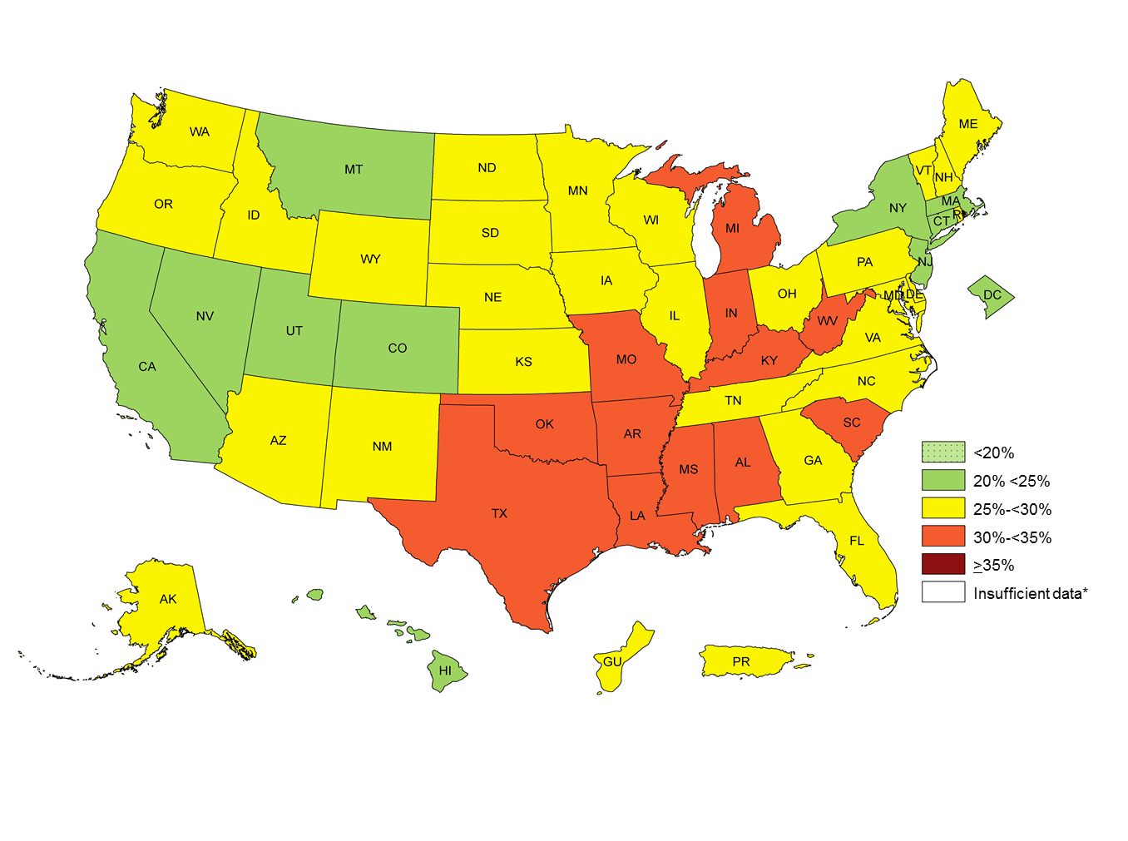
2011 Data
Prevalence estimates reflect BRFSS methodological changes started in 2011.
These estimates should not be compared to prevalence estimates before 2011.
*Sample size <50 or the relative standard error (dividing the standard error by the prevalence) ≥ 30%.

Slide 15
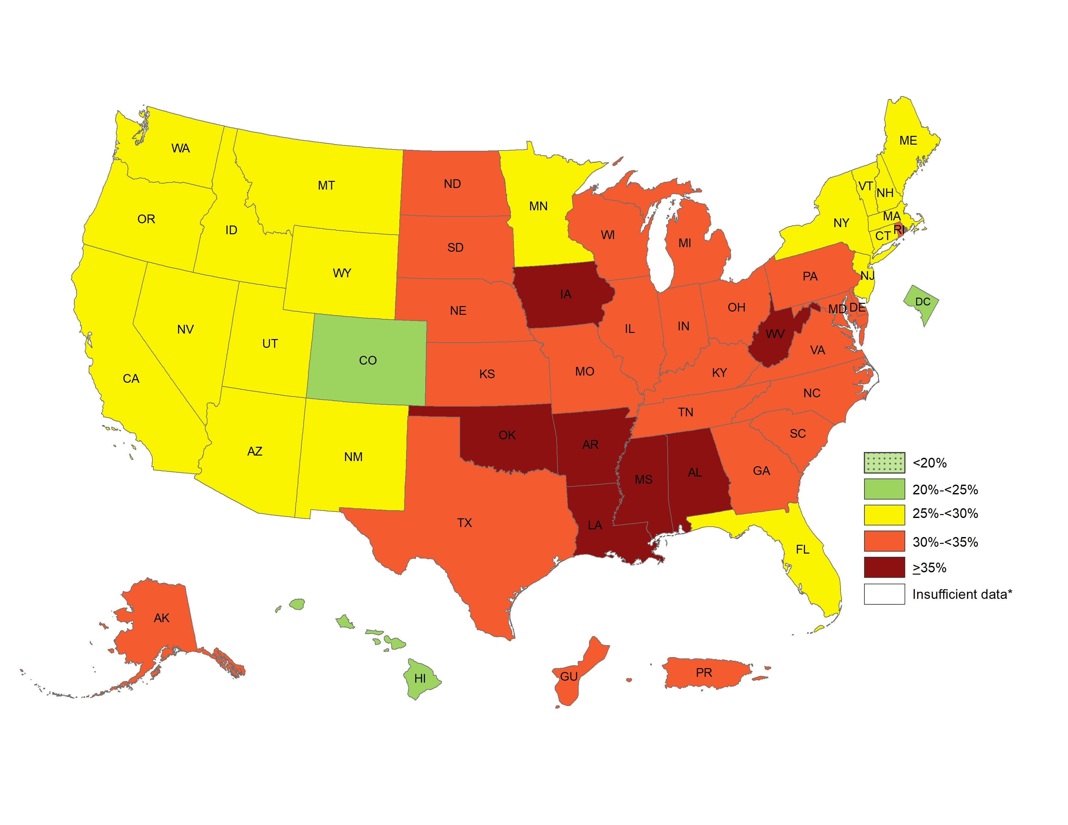
2017 Data
Prevalence estimates reflect BRFSS methodological changes started in 2011.
These estimates should not be compared to prevalence estimates before 2011.
*Sample size <50 or the relative standard error (dividing the standard error by the prevalence) ≥ 30%.

Slide 16
Diagnosed Diabetes, Age-Adjusted Percentage, Adults with Diabetes - U.S. States, 2006
Diabetes Prevalence
Percentage ( Natural Breaks )
2006 Data
Source:
www.cdc.gov/diabetes/data
Disclaimer: This is a user-generated report. The findings and conclusions are those of the user and do not necessarily represent the views of the CDC.
National Center for Chronic Disease Prevention and Health Promotion
Division of Diabetes Translation

Slide 17
Diagnosed Diabetes, Age-Adjusted Percentage, Adults with Diabetes - U.S. States, 2016
Diabetes Prevalence
Percentage ( Natural Breaks )
2016 Data
Source:
www.cdc.gov/diabetes/data
Disclaimer: This is a user-generated report. The findings and conclusions are those of the user and do not necessarily represent the views of the CDC.
National Center for Chronic Disease Prevention and Health Promotion
Division of Diabetes Translation

Slide 18
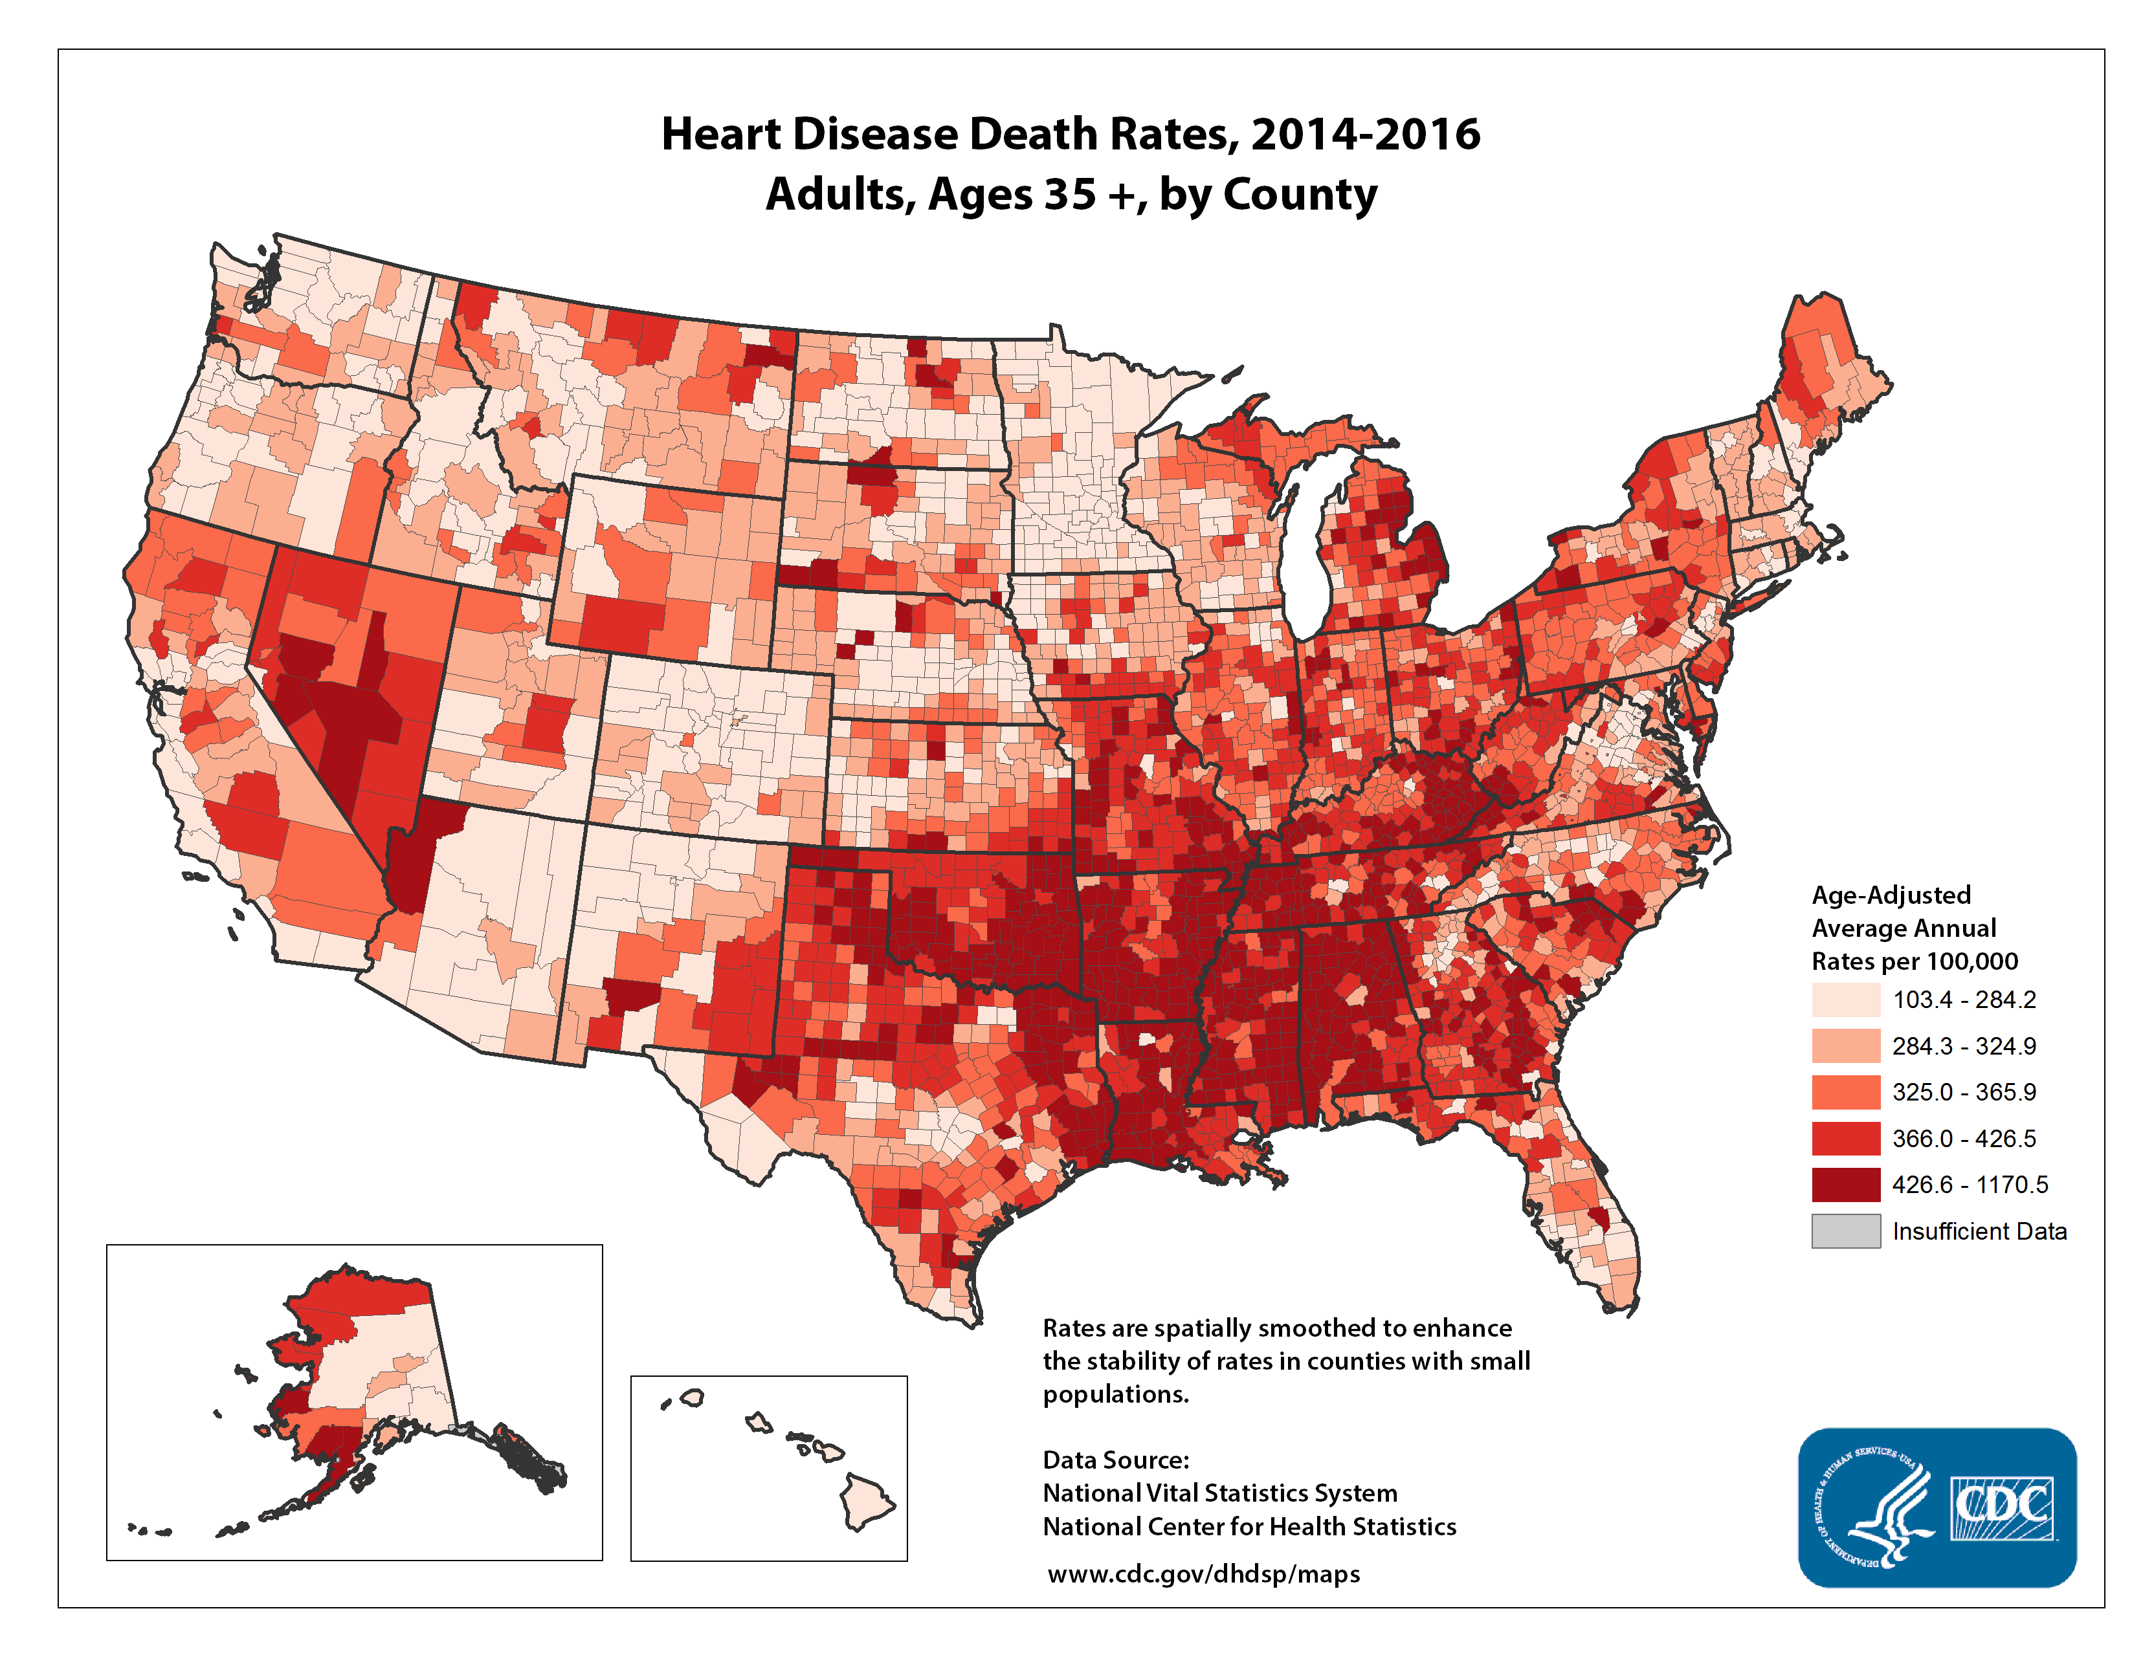

Slide 20
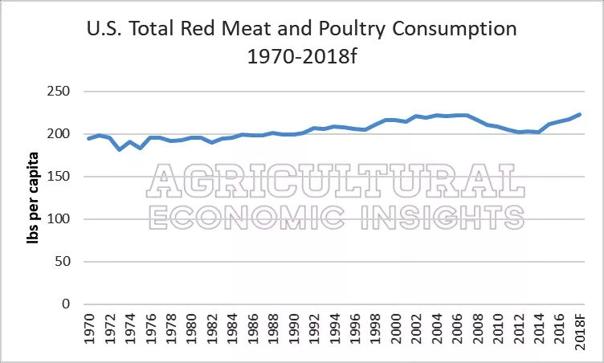

Slide 21
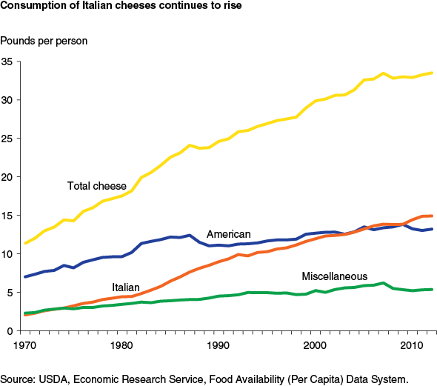

Slide 22
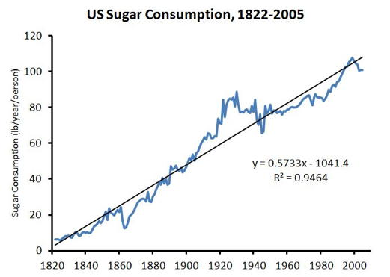

Slide 23
Standard American Diseases
Allergies
Diabetes
Heart Disease
Cancers
Alzheimer’s Disease
Parkinsonism
Arthritis
GERD

Slide 24
Digestive Disease Epidemic
GERD
Eosinophillic esophagitis
IBS
Celiac Disease & Gluten-related disorders
Diverticular Disease
Inflammatory Bowel
GI Cancers
Gallstones
Liver Disease(NASH)

Slide 25
Body System Dysfunction
Neurological/Nervous System
Respiratory System
Cardiovascular System
Gastrointestinal System
Musculoskeletal System
Endocrine System
Immune System
Genitourinary System
Dermatological System
Notes:
Ref 1

Slide 26
Our responsibility
Consider a whole person approach to rehabilitation and incorporate an integrative treatment approach that includes aspects that will improve the overall health and healing of our patient’s injuries, illnesses and diseases that are common to our practice settings.

Slide 27
STATE OF THE PLATE
PART II

Slide 28
The Standard American Diet
Are we truly what we eat?

Slide 29
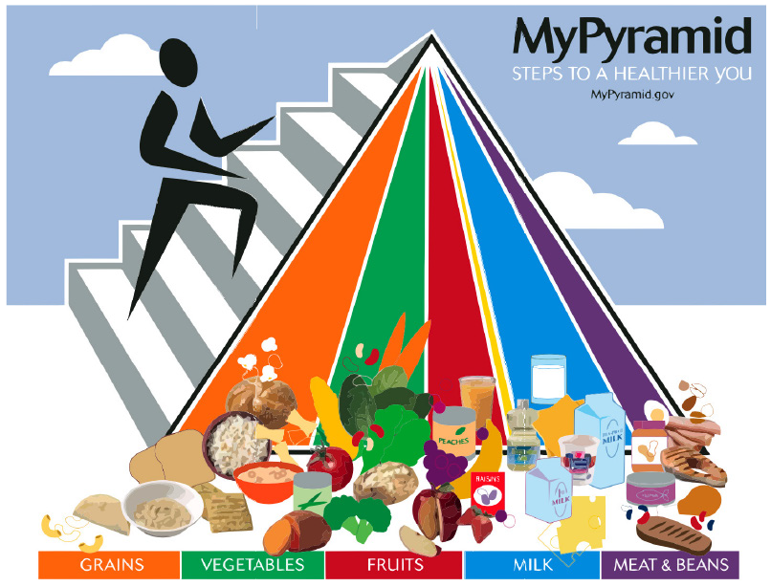

Slide 30
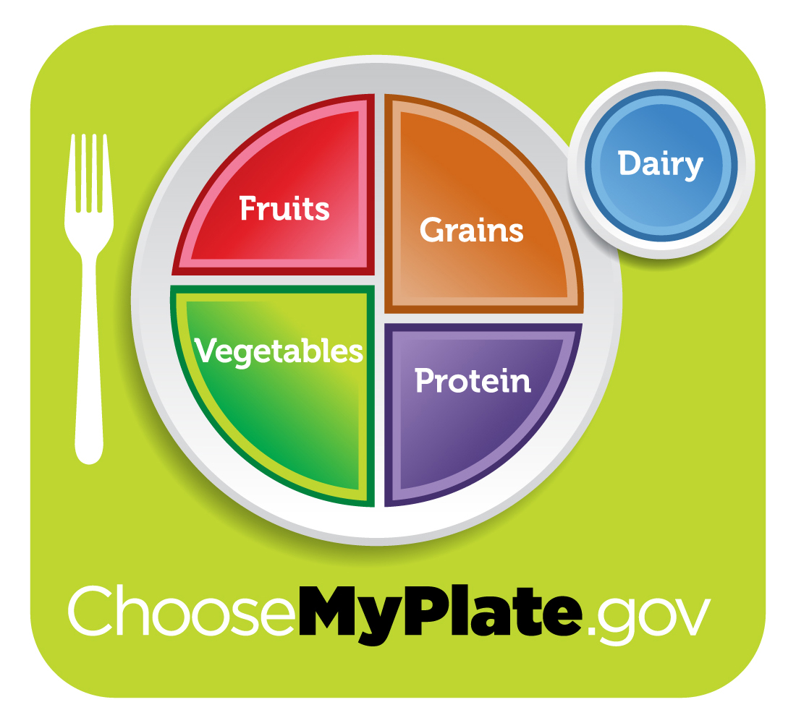

Slide 31
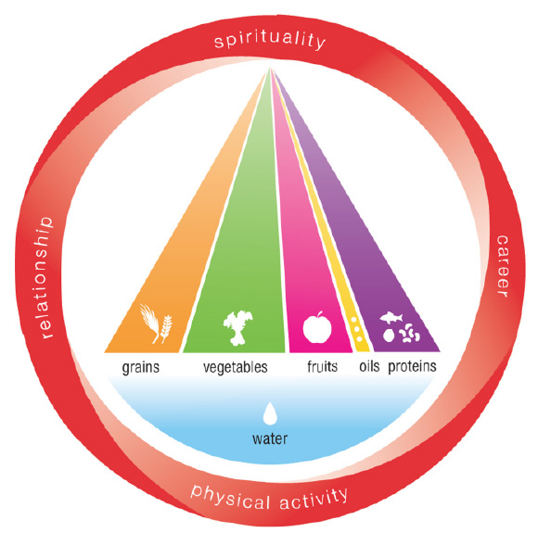

Slide 32
12
THE INTEGRATIVE NUTRITION PLATE
s
P
p
h
i
y
h
s
s
i
Water
o
n
c
a
i
l
t
a
A
l
c
e
t
R
Fruits
Whole Grains
i
v
i
t
y
Fats & Oils
Vegetables
Protein
S
r
p
e
i
r
e
i
r
t
a
u
C
a
l
i
t
y
Integrative Nutrition ® Plate

Slide 33
Oral Phase
Chew food slowly
The enzymes in your saliva start the digestive process.
Chewing assists the digestive process.
Partially masticated food puts stress on the digestive process.
Satiation will be enhanced while eating less food.

Slide 34
Primary vs. Secondary Foods
Primary Foods
Secondary Foods
Sleep habits
Stress levels
Physical activity
Spiritual practice
Social life and relationships
Career and Finances
Whole foods vs. processed foods
Water consumption
Added sugar
Caffeine and alcohol
Intake of common irritants such as dairy, gluten, soy, eggs, and corn

Slide 35
Bio-Individuality
No one diet or lifestyle works for everyone.
One person’s food can be another person’s poison.
Individual dietary needs are linked to gut health.
Activity levels influence dietary needs.
Notes:
Ref 3&4

Slide 36
Symptoms vs. Causes
Symptom | Possible Causes
Pain | Injuries, inflammation, infection
Weakness | Injuries, malnutrition, toxins
Cholesterolemia | Genetics, poor diet, lack of exercise
Hyperglycemia | Diet, low activity, viral illness, steroids

Slide 37
FOOD FOR THOUGHT
PART III

Slide 38
Sensitivities and Intolerances
Food intolerance is a detrimental reaction, often delayed, to a food, beverage, food additive, or compound found in foods that produces symptoms in one or more body organs and systems, but generally refers to reactions other than food allergy.
Food hypersensitivity is used to refer broadly to both food intolerances and food allergies.
Notes:
Ref 6

Slide 39
Allergies, Sensitivities & Intolerances
Food Allergies – the body has an abnormally elevated immune response toward a particular substance that is considered harmless to most people.
Top 8 food allergens:
Eggs
Fish
Milk
Peanuts
Shellfish
Soy
Tree nuts
Wheat
Notes:
Ref 5

Slide 40
Inflammation
Inflammation is good during the healing process unless it does not shut off – then it becomes chronic.
Classic signs of inflammation:
Redness Pain
Heat Swelling

Slide 41
The Gut and Microbiome
70% of the immune system is located in the gastrointestinal tract.
Approximately 2,000 different strains of bacteria live inside or on us. Some are good and some are bad.
When the bad outnumber the good it is called dysbiosis which if left untreated can result in “leaky-gut” syndrome.
Notes:
Ref 7

Slide 42
Microbiome
Affected by:
Mode of delivery
Diet during infancy
Diet during adulthood
Antibiotics
Age
Genetics
Stress
Notes:
Ref 8

Slide 43
Your Brain in Your Gut – The Multi-tasking Microbiota
Direct local and systemic immune function
Cool inflammation
Fight infections
Enhance nutrient absorption
Ensure mucosal layer integrity
Promote optimal bowel motility
Prevent neoplastic changes
Notes:
Ref 9

Slide 44
Gut Irritants
Alcohol
Caffeine
Sugary drinks
Diet sodas
Energy drinks
“Sugar-free” products with polyols
Gummy additives: guar gum, arabic, carageenan

Slide 45
Leaky Gut
Has been demonstrated to cause autoimmune disease.
Case Study by Dr. Susan Blum – 52 year old woman with fibromyalgia and rheumatoid arthritis.
All of her RA labs were normal
Digestive symptoms
Slowly gaining weight for 5 years – now 20 pounds above her normal

Slide 46
Support Your Gut Health
Sleep deprivation is associate with upper and lower GI symptoms independent of Body Mass index.
Stress and pace of modern life has a direct impact on digestion, absorption, barrier function and microbiota.
Notes:
Ref 10

Slide 47
Support Your Microbiome
Prebiotics- fiber sources that ferment in the gut, creating beneficial bioactive compounds:
Jerusalem artichokes, leeks, onions, quinoa, amaranth
Probiotics – Bacteria consumed through the diet (or with supplements) that help support gut health. Common strains include bifidobacterium and lactobacillus.
Food sources: Kefir, tempeh, kimchi, sauerkraut, yogurt
Ref 11

Slide 48
Autoimmune Disorders
The body recognizes itself as an invader and attacks healthy tissue.
The specific cause is often unclear.
Symptoms vary based upon the specific condition, but environmental exposures, like diet and lifestyle, play a role also.
Examples include: Psoriasis, Rheumatoid arthritis, Fibromyalgia, Type I Diabetes, Celiac Disease, etc.

Slide 49
Dr Robin Berzin’s Remedy
Remove inflammatory foods – especially sugar
Consider supplements like aloe, glutamine, licorice, and l-carnitine.
Add probiotics to help populate the gut with good bacteria.
Add prebiotics to feed the good bacteria.
Notes:
Founder of Parsley Health. com

Slide 50
Identifying your triggers of inflammation
The best way to discover sensitivities and intolerances is an elimination diet.
There are lab tests for food sensitivities, but there are no tests for all possible immune reactions.
The most common tests are for IgG food allergy tests.
Good option for children
Not good for gluten

Slide 51
The Brain
Needs: exercise, social connection and good nutrition.
The Alzheimer’s Association reports that over 5 million individuals suffer from the disease, but this is estimated to increase by 11 million by 2050.
Symptoms of impaired brain health include forgetfulness, poor memory, poor coordination, and difficulty focusing and/or completing complex tasks.
Notes:
Ref 12

Slide 52
Change Your Brain – Change Your Life by Daniel Amen, MD
Presents scientific evidence that your anxiety, depression, anger, obsessiveness, or impulsiveness could be related to how specific structures work in our brain.
A study of over 100,000 brains using Single Photon Emission Computed Tomograhy (SPECT).
SPECT is a nuclear medicine study that looks at blood flow and activity and tells us: good activity, too little activity and too much activity.
Notes:
Ref 12

Slide 53
SPECT of brain

Slide 54
SPECT Stroke

Slide 55
SPECT of Alzheimer's

Slide 56
Amen Clinics Method
Four Circles
Biology – genes, diet, exercise, sleep, hormones, brain injuries, health, allergies, toxins
Psychology- how you think, body image, upbringing, developmental events and past emotional traumas
Spirit – what does your life mean, why are you here, what is your purpose
Connections - relationships

Slide 57
What Accelerates Brain Aging
Brain injuries
Drugs and alcohol
Obesity
Sleep apnea
Smoking/caffeine
Diabetes
Hypertension
Toxins
Poor diets/high calories
Stress/depression
Lack of exercise
Bad decisions
Low conscientiousness
Unhealthy peer group
Ignorance of brain vulnerability

Slide 58
What Decelerates Brain Aging
Good decisions
Conscientiousness
Positive peer group
Protecting the brain
Clean environment
Physical health
Healthy weight
8 hours of sleep
New learning
Great diet
Wise kcal spending
Omega 3s
Green tea
Exercise
Gratitude
Stress management

Slide 59
NFL Player Results

Slide 60
Food and Cancer Joel Fuhrman, MD
Refined foods are linked to:
Oral cavity cancer
Stomach cancer
Colorectal cancer
Intestinal cancer
Breast cancer
Thyroid cancer
Respiratory tract cancer
Diabetes
Gallbladder disease
Heart disease
Notes:
Ref 13

Slide 61
Cancers and Consumption of Animal Products
Bladder cancer
Brain cancer
Breast cancer
Colon cancer
Endometrial cancer
Intestinal cancer
Kidney cancer
Leukemia
Lung cancer
Lymphoma
Oropharyngeal cancer
Ovarian cancer
Pancreatic cancer
Prostate cancer
Skin cancer
Stomach cancer

Slide 62
WHAT IS ON YOUR PLATE?
PART IV
THE FINAL CHAPTER

Slide 63
How can we help our patients become more health savvy?
Consider IIN Healthy Plate and healthier food choices.
Encourage physical activity.
Be a resource – books, web-sites, health coaches, nutritionists, dieticians, etc.
Generate awareness that healthy changes in can make a big difference in health, energy and overall quality of life.
Encourage reduction or elimination of caffeine and sugar

Slide 64
Barriers
People do not know they can achieve better health.
People do not know how or where to start.
Too much faulty information about diet, exercise and healthy lifestyles.
Financial limitations – eating healthier is more expensive
Health practitioner guidelines geared toward medications instead of diet and lifestyle changes.
Food, drug and alcohol addiction.

Slide 65
Cooking Healthy
FRESH is best
BUYING LOCAL is even better
ORGANIC is much better
Commercial produce is OK
Canned and frozen are also OK
Pasture raised and grass fed is best for animal products
NON GMO is best
Keep it Simple
Buy whole grains – quinoa, amaranth, barley, whole oats, brown rice, etc.

Slide 66
Dr. Fuhrman’s Questions EAT TO LIVE
What if all Americans:
Ate a large bowl of green salad daily
Had a large serving of steamed greens daily
Ate a cup of beans daily
Had at least an ounce of raw seeds and nuts daily
Ate at least three fresh fruits daily
Had some tomatoes, peppers, onions, mushrooms, herbs and garlic daily
Notes:
Ref 13

Slide 67
Case Study: EM July 2008 Joel Fuhrman, MD
300 lbs.
Had quadruple bypass
BP was 161/110 on meds
Waist was 58”
Total cholesterol 228 on meds
BMI 41.5
Triglycerides 312
LDL 148

Slide 68
2008 - 2009
2008
300 lbs.
BP 161/110 on meds
Waist 58”
Total cholesterol 228 on meds
BMI 41.5
Triglycerides 312
LDL 148
2009
160 lbs.
BP 115/70 no meds
Waist 34”
Total cholesterol 132 no meds
BMI 21.7 healthy
Triglycerides 63
LDL 75

Slide 69
Dr. Joel Fuhrman’s Recommendations
Avoid ALL refined carbohydrates such as white bread and pasta.
Do not consume any fruit juice or dried fruits. Avoid all sweets except for fresh fruit in reasonable quantities.
The best fruits are those with less sugar – grapefruit, oranges, kiwifruit, strawberries, green apples and other berries.
Avoid all oil. Raw nuts are permitted – 1 oz.

Slide 70
Fuhrman Recommendations continued
Green vegetables and beans should make up most of your diet.
Limit animal food intake to no more than 2 servings of fish weekly.
Exercise regularly and consistently. Do it on a regimented schedule, preferably twice daily.

Slide 71
IIN: Clean Eating 101
Keep it whole
Home cooking
Limit processed carbohydrates
Eliminate all added sugars
Maintain consistent eating times and don’t skip meals
Balance your plate
Emphasize quality over quantity
Clean 15 and Dirty Dozen
Notes:
Ref14

Slide 72
Questions?????

