Slide 1
2019 TEXAS PHYSICAL THERAPY ASSOCIATION ANNUAL CONFERENCE The Woodlands, TX October 12th-13th

Slide 2
Conference Overview
CCU’s
Please note that in order to receive continuing education credits, you are required to sign-in AND out at each session. You must attend the entire session to receive credit. Credit will NOT be issued after conference if requested via phone or email for attendees who did not sign-in AND out.
Credits from conference can be accessed in your TPTA Profile at www.tpta.org. Login to the same profile used when registering for conference to access credits November 15, 2019.
Notes:
How presentation will benefit audience: Adult learners are more interested in a subject if they know how or why it is important to them.
Presenter’s level of expertise in the subject: Briefly state your credentials in this area, or explain why participants should listen to you.

Slide 3
Pelvic Floor Basics - bringing it to your practice - Donna Carver, PT
purelypfrehab@gmail.com
3
Notes:
1 min per slide slides 1-48

Slide 4
Content
Pelvic Floor Diagnosis
A brief description of the varied diagnosis referred for pelvic floor rehabilitation.
A brief description of other diagnosis that may contain pelvic floor dysfunction
Pelvic Floor Treatment Interventions
A brief description of treatment interventions used in pelvic floor rehabilitation.
A brief discussion on how too look differently at current treatment interventions so they include the pelvic floor
Sample Exercises
Some examples of exercises that can be used and how to modify them to include or be specific to pelvic floor dysfunction

Slide 5
Commonly Referred Pelvic Floor Diagnosis
Men
Women
Urinary Incontinence
Interstitial Cystitis
Pelvic Pain
Vulvodynia / Vestibulodynia
Dysparenia
Organ Prolapse
Post-operative
Bladder sling
Pregnancy – pre and post
Diastasis Recti
Constipation / IBS
Dyssynergia – anismus
Urinary Incontinence
Pelvic Pain
Testicular, Penile, Scrotal, Groin
Interstitial Cystitis
Prostatitis
Post-operative
Prostatectomy
Urethal stricture
Diastasis Recti
Constipation / IBS
Dyssynergia – anismus

Slide 6
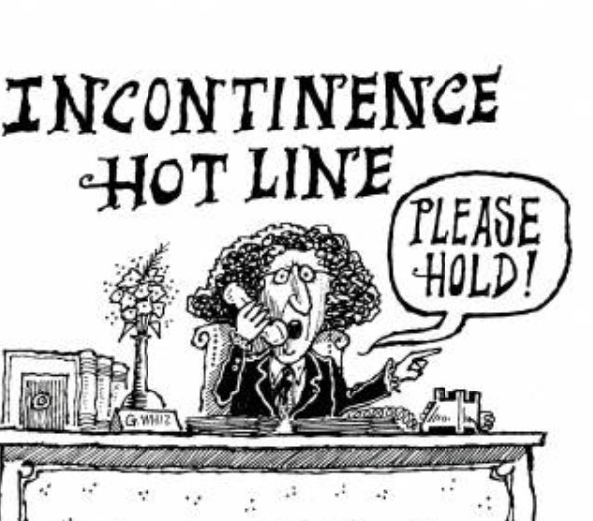
Urinary Incontinence
Types
Urge - suddenly feeling the need or urge to urinate for no apparent reason
Stress - insufficient strength of the pelvic floor muscles to prevent the loss of urine, especially during activities
Mixed - combination of stress and urge
Overflow - constant dribbling or continuing to slowly leak for some time after normal urination.
Functional/Structural - due to structural problems, medications or health problems making it difficult to reach the bathroom in time

Slide 7
Pelvic Pain
Types
Vaginissmus
Dyspareunia
Vulvo – Vestibulo –dynia
Pudendal Neuralgia
SI joint / pubic bone / tailbone
Pelvic Inflammatory Disorder
Post-Partum
Varicose Veins – “congestion syndrome”
Myalgia – muscle tension

Slide 8
PUDENDAL NEURALGIA
Can also report symptoms of burning / hot poker sensation, numbness, abnormal sensitivity, electric shocks, throbbing in the vulva/scrotum, knife-like stabbing pain, twisting or pinching or aching pain, feeling of a lump or foreign body in the vagina or rectum, constipation, pain and straining with bowel movements, straining or burning when urinating, never feeling empty, painful intercourse, loss of arousal, pain with arousal, or pain after orgasm.
The primary symptom is pain in the genitals or the anal-rectal area and the immense discomfort is usually worse when sitting.
About 2/3 of patients are women
Often misdiagnosed as bladder infection, prostate infection, endometriosis, interstitial cystitis or sciatica.

Slide 9
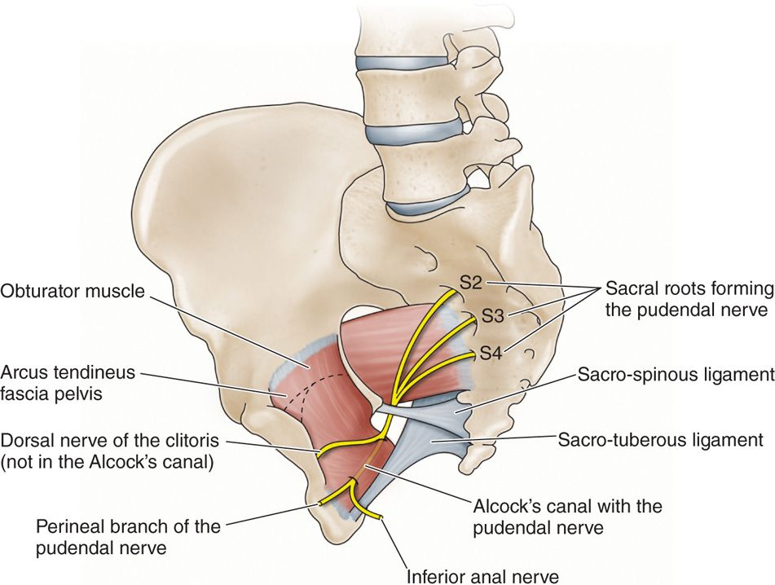
PUDENDAL NEURALGIA
Caused by inflammation of the nerve or by mechanical damage/trauma to the nerve.
Compression of the pudendal nerve can occur by nearby muscles or at the sacrotuberous ligament (Alcock canal syndrome)
Repeated minor damage to the pelvic area from prolonged sitting, cycling, horse riding or chronic constipation

Slide 10
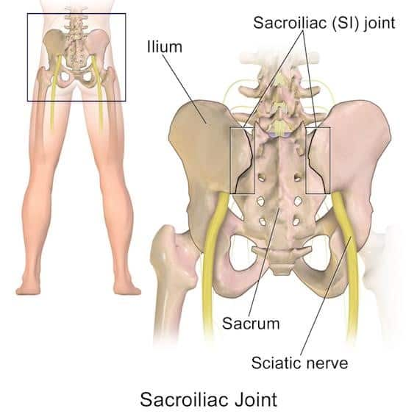
SI joint / pubic bone / tailbone
All hurt with sitting
Causes:
fracture, childbirth, fall, sports injury, repetitive stress, congenital abnormality, Infections, tumors/cysts, degenerative arthritis or other spinal injury/condition (spurs, nerve root compression, DDD)
Sacroiliac Joint - pain deep at the SI joint with radiation of symptoms along the low back and hip/buttock
Upslips, Downslips
Sacral nutation and Counter-nutation (normal during flexion and extension)
Anterior rotation (accentuates a lumbar lordosis),
Posterior rotation (reduces it)

Slide 11
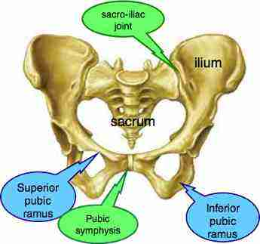
SI joint / pubic bone / tailbone
Coccydynia - dull or sharp pain
aggravated with direct pressure, increased intraabdominal pressure (i.e. sneezing, coughing), sitting and walking.
Pubic Symphysis - a dull ache or sometimes sharp pain at or along the pubic symphysis or pubic bones; pain may radiate down the front/inner thighs.
Symptoms with walking, weighted and unweighted single leg activities (i.e. climbing stairs, putting on pants) and asymmetrical positioning ( i.e. sitting cross-legged, carrying items on one side).
Notes:
Basic Treatment:
(1) provide education (i.e. on body mechanics, birthing positions)
(2) recommend tools/techniques (i.e. pelvic stability belts, taping)
(3) perform manual therapy (i.e. joint mobilization, myofascial trigger point release, muscle energy techniques, connective tissue manipulation)
(4) individualized home exercise programs (i.e. deep core strengthening, neuromuscular re-education, aquatic exercise).

Slide 12
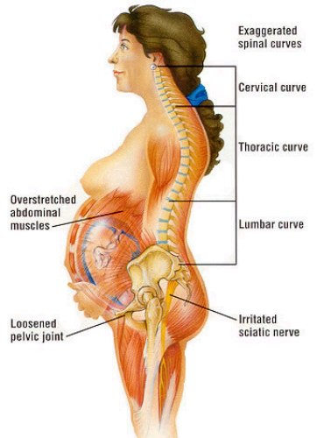
Pregnancy Pre and Post Partum
When a woman goes through a pregnancy and delivery, the pelvic floor muscles, fascia, and nerves are damaged.
13-36% of pregnant women who have a vaginal delivery experience pre/post-partum symptoms
Other post-partum complications:
Mastitis, pudendal nerve during birth, joint irritation, voiding difficulty, depression, endometriosis, thyroiditis, fatigue, constipation, anemia

Slide 13
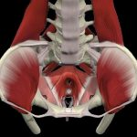
Post-Partum Myalgia
May be caused by a direct injury to a muscle.
Pelvic and rectal pain attributed to pelvic floor dysfunction.
The muscles do not act in a coordinated manner; muscles may be weak or may tighten or spasm
Hypertonic muscles may cause urinary frequency, urgency, stopping and starting of the urine stream, painful urination or incomplete emptying of the bladder.

Slide 14
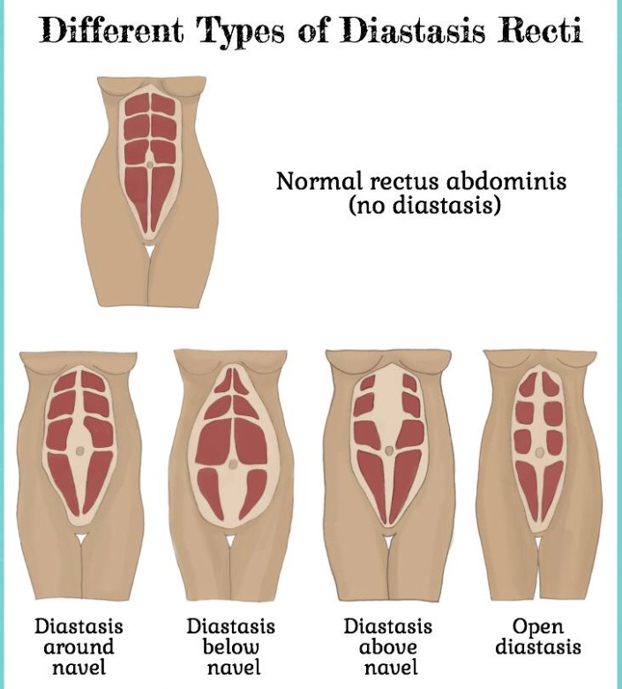
Diastasis Recti
A condition in which the support system (muscles) for the back and organs weaken causes the connective tissue to tear away from the abdominal wall; the abdominal muscles separate, causing a hernia.
can occur during and after pregnancy.
Identified as a bulge in the belly that might be noticeable only when the abdominal muscles are tense, such as during coughing or getting up from lying.
Symptoms: Back pain, poor posture, pelvic floor problems like pain and incontinence, gastro- intestinal disturbances like constipation and bloating
Can require surgery to repair.

Slide 15
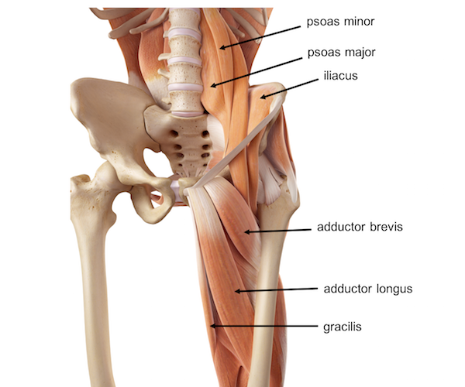
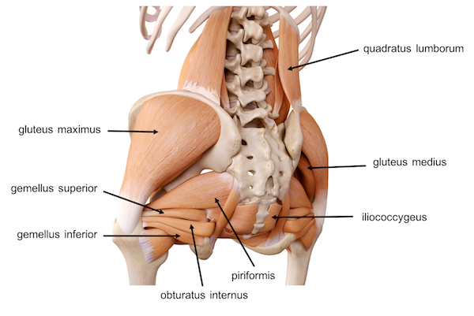
Common Physical Therapy Diagnosis That May Have Pelvic Floor Dysfunctions
Low Back Pain
Hip Pain
Sciatica
SI Joint Pain
Thoracic or Lumbar Disc
Groin Pain / Strain
Hamstring Pain / Strain
Abdominal Pain / Strain
Anything attached to the Pelvis!

Slide 16
BE AWARE
Performing exercises with any of the muscles attached to the pelvis, without consideration for pelvic floor function can
cause
increase
contribute to
**** Pelvic Floor Dysfunction ****

Slide 17
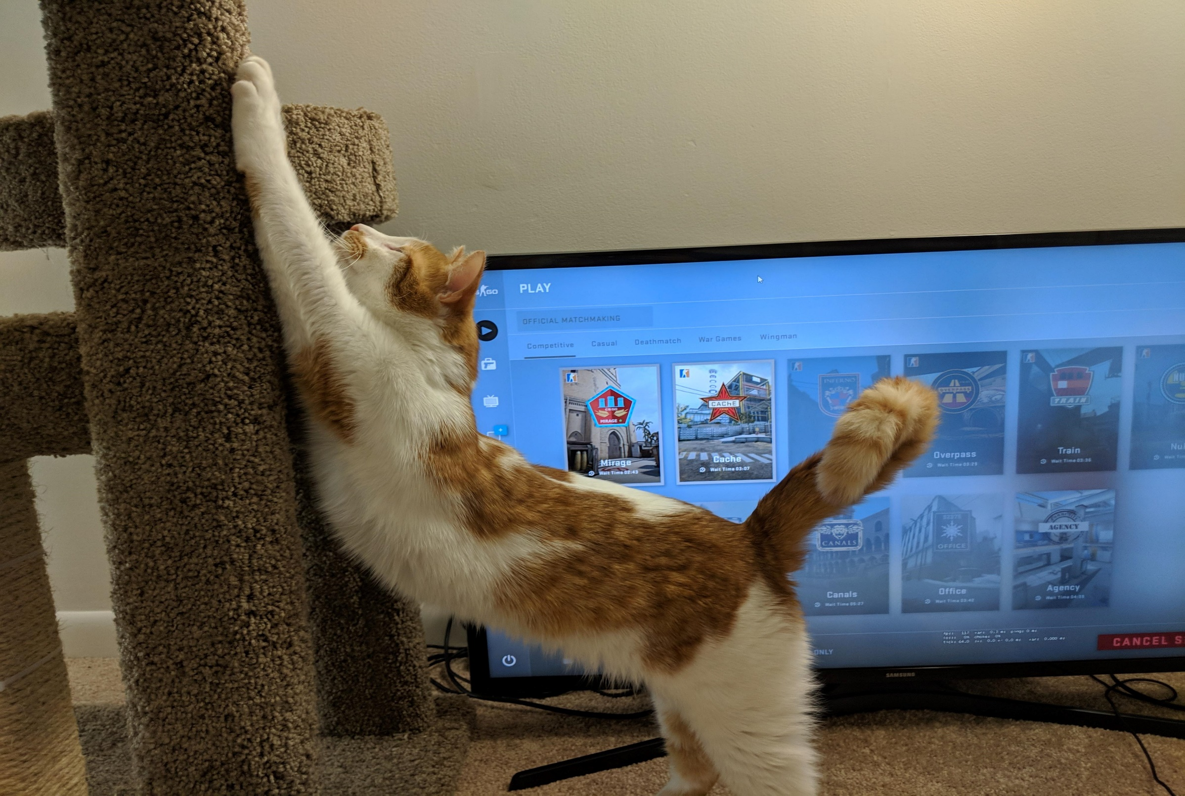
Stretch Break

Slide 18
Pelvic Floor Treatment Interventions

Slide 19
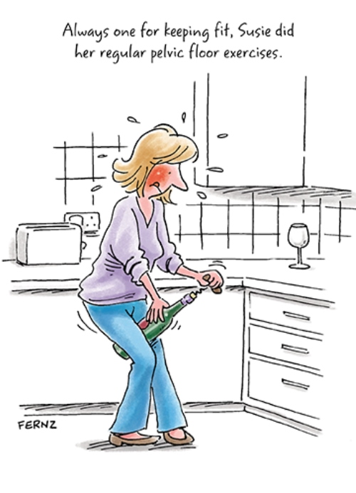
Pelvic Floor Treatment Interventions
Pelvic Muscle Rehabilitation
Biofeedback
Electrical Stimulation
Manual Intervention
Dry Needling
Ultrasound – therapeutic
Cold Laser
Vaginal Dilators
Patient Education
Other Exercises and home products
19

Slide 20
Purpose of muscle rehab is re-education, modification, and retraining of specific muscle groups. APTA recommends Kegel’s as the first-line of treatment Patients are initially seen weekly Research says should take no more than 8-10 sessions.
Pelvic floor muscle exercises involve contracting, holding, and releasing the pelvic floor muscles, but how do patients know they are using the right muscles?

Slide 21
Pelvic Muscle Rehab
Pelvic muscle rehabilitation (PMR) is a non-invasive treatment involving cognitive reeducation, modification, and retraining of the pelvic floor and associated musculature. 8-10 sessions
Isolate the muscles
Eliminate muscle substitution
Inhibit muscle tone/improve resting tone
Gain PF muscle strength, improve muscle recruitment
Improve muscle endurance
Teach muscle control
NOT JUST KEGEL’S - other muscles in the pelvis
Kegel’s
https://www.youtube.com/watch?v=c9UDKATwuVA
Notes:
Purpose of muscle rehab reeducation, modification, and retraining
Start with Kegel instruction/assessment
APTA recommends Pelvic floor muscle exercises to involve contracting, holding, and releasing pelvic floor muscles, Kegel’s are recommended as the first-line of treatment.
Patients are initially seen weekly
Research says should take no more than 8-10 sessions.
HEP several times a day, and for 12 to 20 weeks.

Slide 22
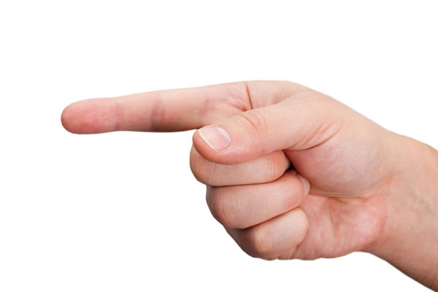
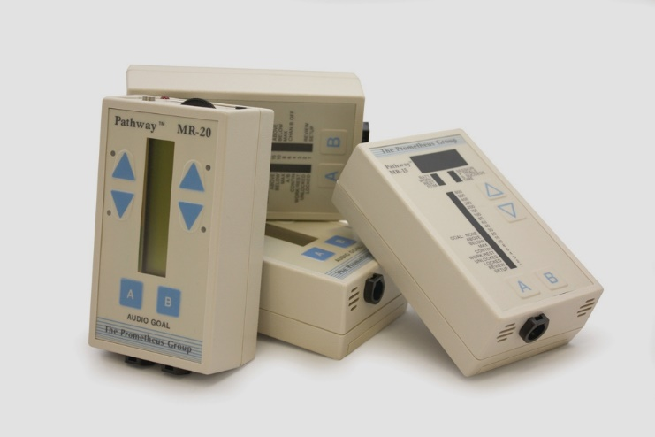
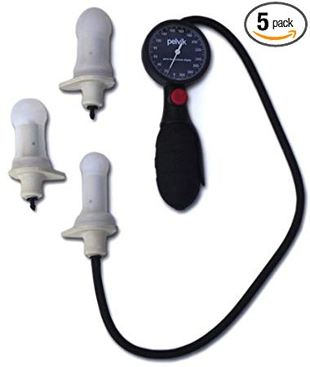
Biofeedback
A vaginal or rectal probe or electrodes stuck to the perineum and or peri-anal areas are used to either assist a patient with muscle strengthening or to help a patient learn how to relax their pelvic floor with feedback for the muscle activity; patient visualizes muscle activity in a variety of ways
Surface electromyography (EMG) helps to facilitate awareness of the muscle contraction during exercise.
Studies have found that patients treated with biofeedback see a 63% reduction in urinary stress incontinence.
Notes:
Correct contraction can be verified by biofeedback or manual palpation.
Patient can see almost instantly their muscle output during exercise.
Based on the literature, PF exercise with biofeedback is not more effective than PFME alone
There are no studies that PFM training will improve SUI.

Slide 23
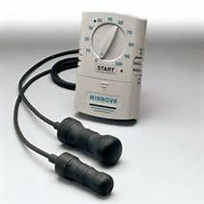
Electrical Stimulation
Facilitating a muscle contraction using electric impulses. ... The impulses mimicking the action potential that comes from the central nervous system, causing the muscles to contract
When the pelvic floor muscles are weak or has little endurance the aim would be to use stimulation to ‘wake up’ your pelvic floor and then as the control of the pelvic floor improves then discontinue stimulation and begin retraining.
Units
Pelvic Floor / Bladder Stimulator, PTNM - Posterior tibial neuromodulation, NMES, Interstim surgically implanted sacral nerve stimulator
Notes:
Generally chosen because if the need to RE-TRAIN a specific muscle or strengthen weak muscle
Objective of PF EMS are to improve muscle strength, to normalize the reflex activity and to increase circulation
EMS of the pudendal nerve improves urethral closure by activating the PFM.
It may also increase conscious awareness of the action of these muscles to improve ability to perform a voluntary muscle contraction.
Can be used to fatigue muscle - Higher intensity and higher frequency (100 Hz) along with high (60) pps induce stronger muscular contractions, and thus quick muscle fatigue.

Slide 24
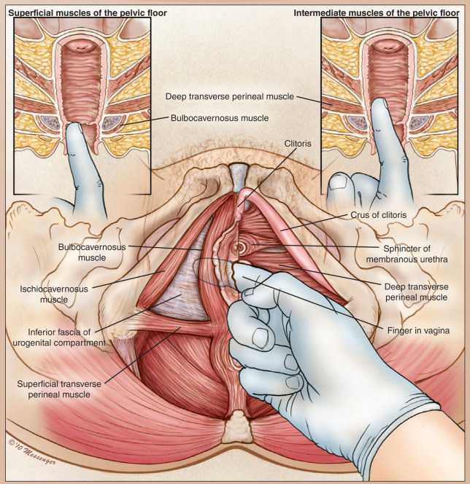
Manual Intervention
Myofascial physical therapy consisting of targeted internal and external tissue manipulation that targets specific muscles and connective tissues of the abdomen, pelvic floor, and hip girdle for the purpose of muscular relaxation or decreasing painful scar tissue attachment, increasing general circulation, freeing tissue, and releasing nerve entrapment by surrounding structures.
Internal
Pelvic floor muscles: Ischiocavernosus, Bulbospongiosus, Transverse Perineal, Pubococcygeus, Iliococcygeus and Obturator Internus
Using the wand – by patient or PT
https://vimeo.com/173756917
Therawand 1:07
Notes:
Same as internal exam – follow the “clock” method.
Patient or PT can use wand - enables control the exact amount and location of pressure applied.

Slide 25
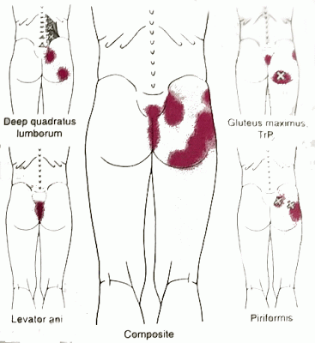
Manual Intervention - External
Trigger point release to quadratus lumborum, hip flexor, TFL, gluts, piriformis
Identify the “Hot spot”
Help eliminate pain, relieve tension, increase circulation, help muscles regain function and promote ROM
Roll on the foam roller/ball
https://www.youtube.com/watch?v=x7HepxwsY4Y 1:47 – 3:53
Manual stretching - quadratus lumborum, hip flexor, TFL, gluts, piriformis, sacrotuberous ligament
Notes:
Trigger points can develop in any of the pelvic floor muscles, and usually refer sensation or pain.
Avoid applying pressure on bones and joints, pain is Not the purpose
Adductor muscles have trigger points which can refer pain into the anus and genital areas
Correct positioning for manual stretching

Slide 26
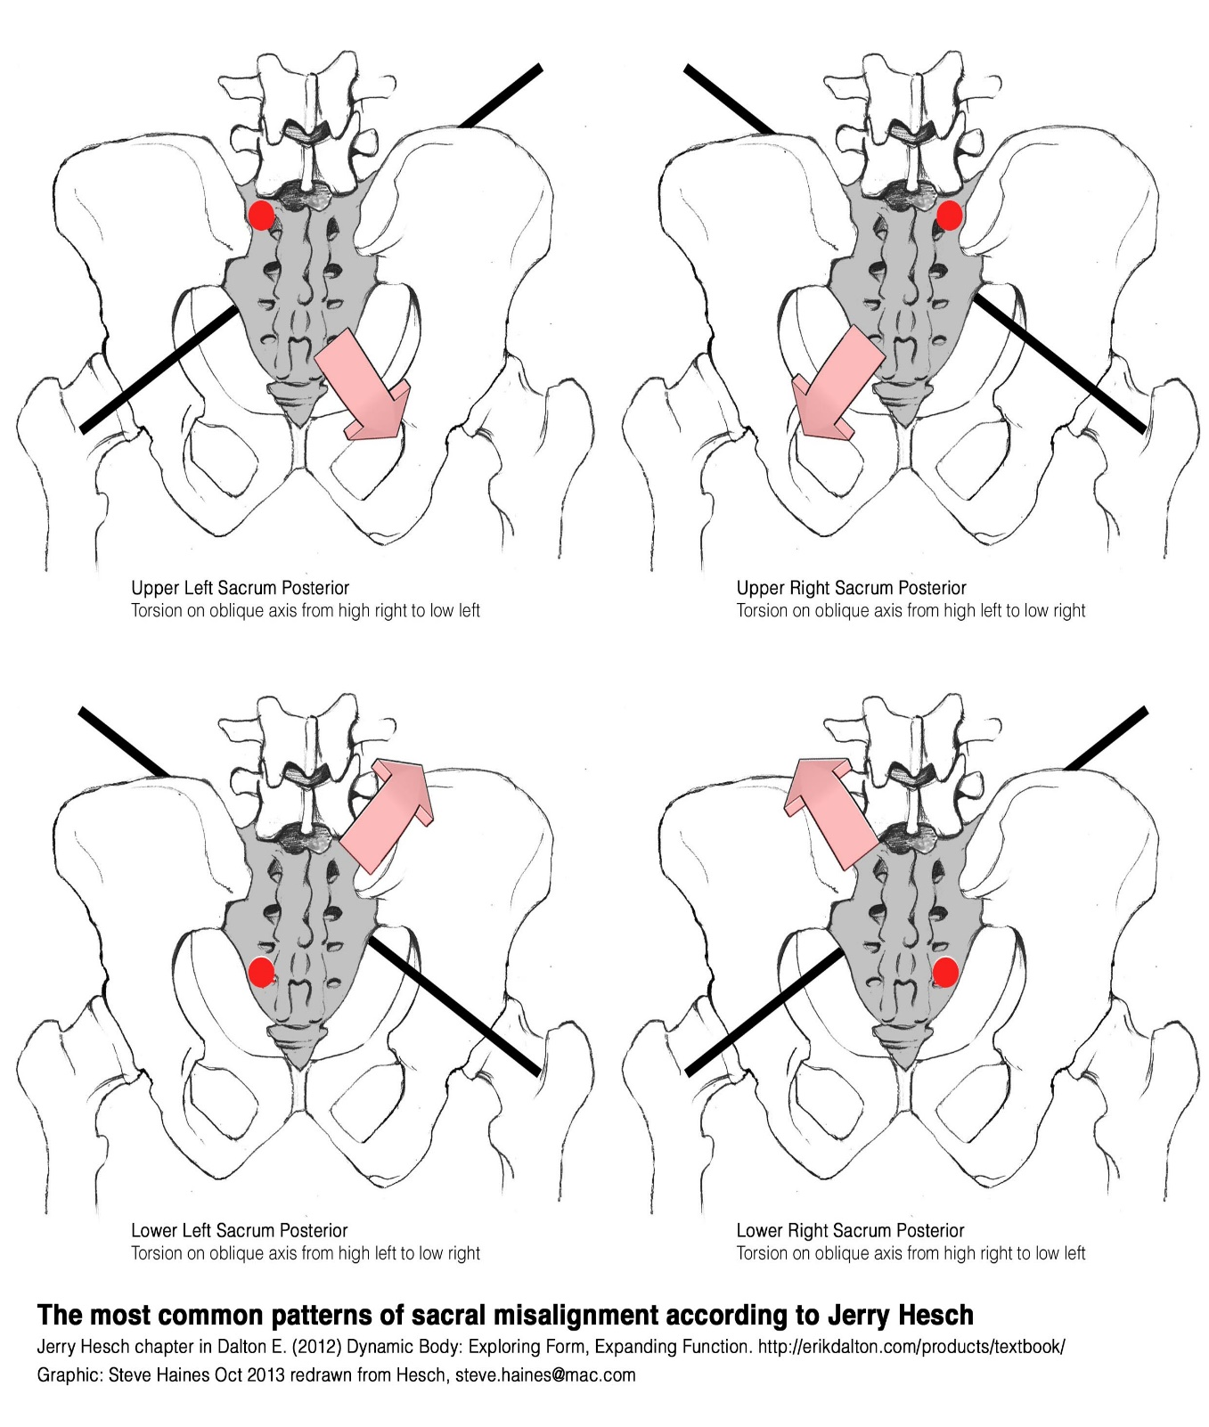
Manual pelvic alignment
Coccygeal adjustment
https://www.youtube.com/watch?v=LKiP-jYVZUY
Long-axis leg traction techniques
https://www.youtube.com/watch?v=_J4bC9qdA5Y
Side-lying manipulation
https://www.spine-health.com/video/chiropractic-adjustment-sacroiliac-joint-video

Slide 27
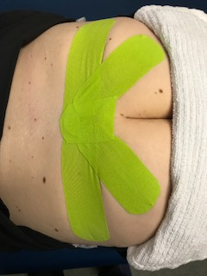
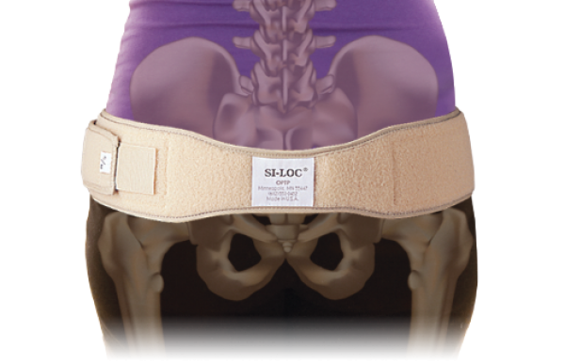
SI Correction
Kinesiotaping -
lift the overlying tissue off of your painful SI joint, and this can help decrease the pressure around your joint.
lifting off of tissues helps to create a pressure differential under the tape, and this allows for increased circulation to the tissues surrounding your SI joint. This increased circulation helps to bring in fresh blood and nutrients, and this can help create an environment where optimal healing can take place.
helps to facilitate proper muscular activation in the muscles around the SI joints. This improved muscular activation helps to keep your pelvis and SI joints in the proper position, and thus relives your SIJ pain.
SI Loc / Bracing-
sacroiliac belt supports and compresses the SI joint.
to reduce laxity of the sacroiliac joints and improve stability
the surfaces of the sacroiliac joints are pressed together, which increases friction and reduces shearing forces.

Slide 28
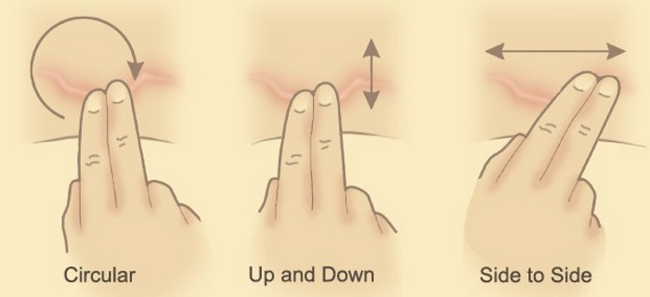
Massage Techniques
Scar massage is different than the typical massage.
reduce adhesions in underlying connective tissues and myofascial layers with the purpose of increasing blood flow, decreasing nerve irritation, and decreasing pain.
Use two fingers to make small circles over the length of the scar and the skin surrounding it then use two fingers to push the scar up-and-down.
Skin rolling technique (a combination of myofascial release and petrissage)
myofascial release
identify and treat areas of restriction or abnormal cross-linking of fascia or connective tissue in a painful area in the body.
It is important to understand 'fascia' in order to understand the technique
fingers move along the surface of the skin continuously picking the skin up to stretch the subcutaneous fascia
https://www.youtube.com/watch?v=v0DMq-qvp4w
https://www.youtube.com/watch?v=ZnrI4PTkb9E

Slide 29
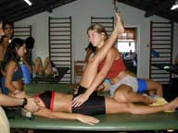
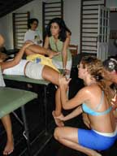
Muscle energy techniques
Functional position with alternating contraction and relaxation of muscle.
Isometric contractions to facilitate and inhibit muscle movement to correct structural/skeletal alignment.
Must know the muscles that are causing the mal-alignment
Patient contracts muscles for around five seconds against the resistant force that’s being applied by the physical therapist.
This is done between three and five times

Slide 30
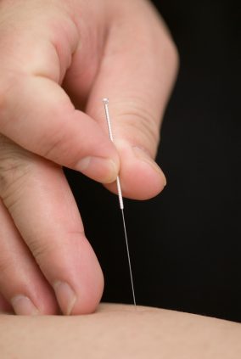
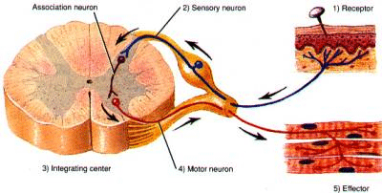
Dry Needling
Dry needling is the most popular and fastest growing intervention in physical therapy today.
There has been a remarkable increase in continuing education offerings and published research.
APTA stance is that PTs should implement dry needling into practice.
The Board does not recognize that PTAs have the skills to perform this invasive procedure at this time. However, PTAs should recognize when the intervention is needed.
A skilled intervention that uses a thin needle to penetrate the skin and release tight muscle bands and stimulate underlying myofascial trigger points, muscle, and connective tissue.
Dry needling will assist with the restoration of muscle function, to reduce muscle tension (spasms), improve proprioception, reduce and eliminate pain, and normalize tissue sensitivity to optimize patients’ function and quality of life.
Dry needling of the pelvic floor includes:
the thoracolumbar spine, abdomen, pelvis and hip joint complex
Muscles: gluteals, quadratus lumborum, rectus femoris, vastus lateralis/ITB/TFL, adductor and piriformis
http://www.womenshealthapta.org/talking-points-an-oxford-style-debate-on-dry-needling/ APTA debate video

Slide 31
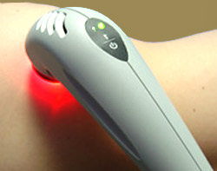
Cold Laser
Cold Laser Therapy or Low Level Laser Therapy (LLLT) is a treatment that utilizes specific wavelengths of light to penetrate 2 to 5 centimeters below the skin to interact muscle, ligament, cartilage, and nerves.
Since 1967 there have been over 2,500 clinical studies published worldwide
Used with pelvic floor conditions since 2005 for a variety of conditions like vulvodynia, Caesarian scar pain, dyspareunia, and bladder pain.
A proven method for pain relief
Produces no heat, and does not cut, coagulate or vaporize any tissue
Used on a variety of acute and chronic musculoskeletal conditions in order to help eliminate pain, swelling, reduce spasms and increase function
Laser therapy helps to decrease pain and inflammation, improve nerve function, prevents keloids in scars and improves blood circulation to the tissues.

Slide 32
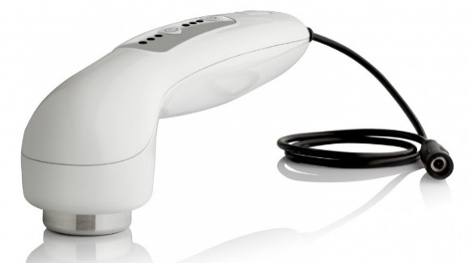
Ultrasound
Has been used by physical therapists since the 1940s
effective in patients with chronic pelvic pain, interstitial cystitis, and other pain related conditions
Alternating sound waves are generated by a piezoelectric effect caused by the vibration of crystals. The sound waves that pass through the skin which causes vibration or cavitation in the local tissues resulting in a deep localized heat
Therapeutic ultrasound is used to help reduce spasm, increase blood flow, promote healing and reduce inflammation.
Ultrasound energy penetrates up to 4 cm below the surface and the therapeutic thermal action reaches up to 10 cm from the device

Slide 33
Other Interventions

Slide 34
Patient Education
Offer patient resource list – provide contacts for community resources and internet sites for more information on specific diagnosis
Example: http://www.beyondbasicsphysicaltherapy.com
Explain the relationship between the pelvic floor muscles, bowel, bladder, sexual health and reproductive health; use models and pictures
Take time to answer questions and give the patient ‘homework’ to bring questions in each visit.
Provide a home program with no more than 2 exercises or tasks at a time.
Teach compensatory strategies
anticipatory pelvic floor muscle contraction immediately prior to an activity that causes urine leakage

Slide 35
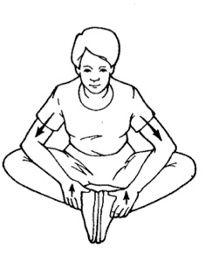
Other Interventions
Vaginal dilators have been around for at least 50 years
5 to 10 minutes each session every other day
Gradually move to a larger size
Toileting / Postural / Diet -- Retraining
Give patient a voiding/toileting diary and review results with patient
Toilet schedule / prompted voiding / habit training
Identify postural impairments and discuss with patient how to sit, stand, sleep and walk with improved posturing.
Certain foods and beverages are thought to contribute to bladder symptoms
APTA launches new nutrition webpage: http://www.apta.org/PTinMotion/News/2017/6/9/NutritionWebpage/
Core Stabilization
Spinal mobility / Functional Movements
Stretching
SI joint – Strengthening / Stabilization

Slide 37
What have you already seen?
Pelvic Floor Symptoms
in everyday clinical practice

Slide 38
external muscles that can contribute to pelvic Floor dysfunction
You may already be treating a musculoskeletal problem that is also contributing to pelvic floor dysfunction.

Slide 39
external muscles (see handout)
Quadratus Lumborum
Iliopsoas
Rectus Abdominus
Transverse Abdominus
Adductor Magnus
Pectineus
Paraspinals
Gluteals
Pyrimidalis

Slide 41
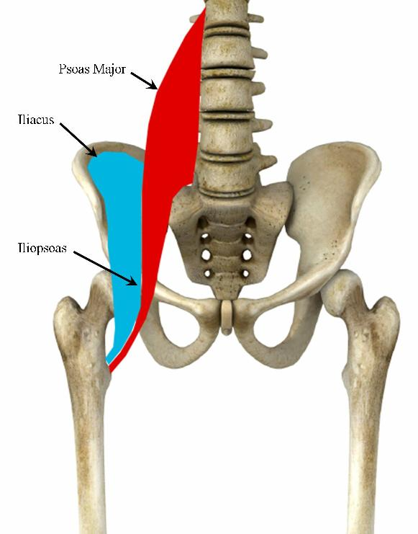
Iliopsoas
Strongest Hip Flexor
Assists with External Rotation
Important for standing, walking, and running
Can cause pain in the low or mid back, SI joint, hip, groin, thigh, knee, or any combination

Slide 42
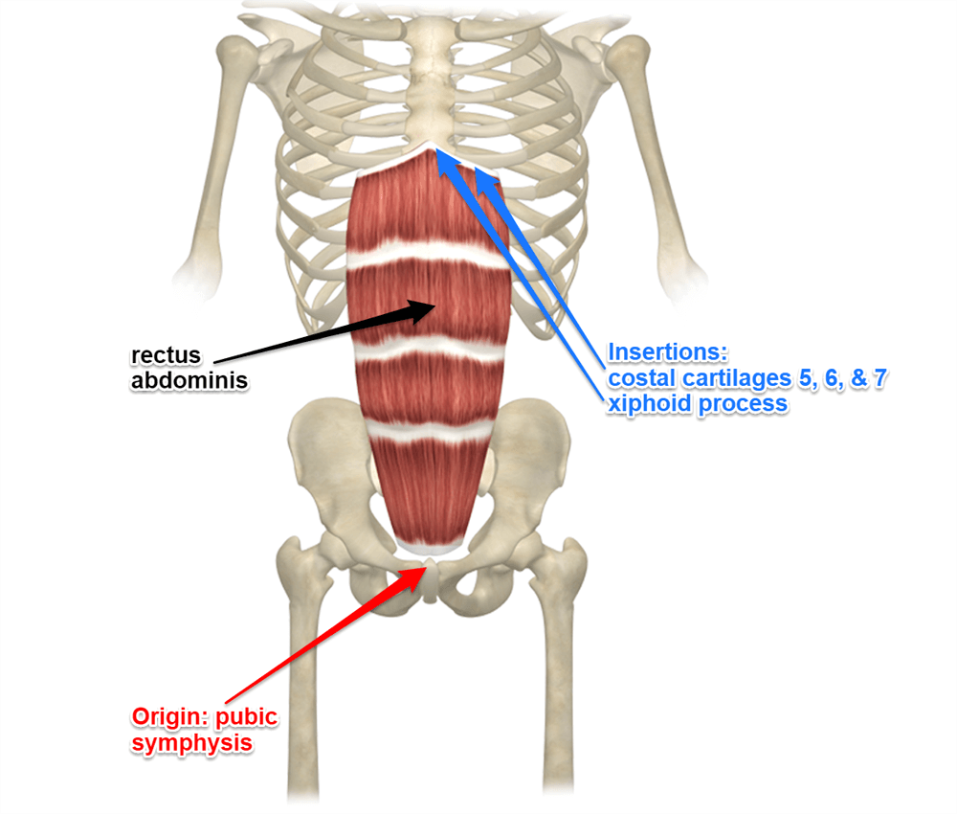
Rectus Abdominis
Attaches to the ribs and the pelvis (pubic symphysis and pubic crest).
Posteriorly tilts the pelvis, decreases lumbar lordosis by flexing the vertebrae
Contracts when a child is delivered, during bowel movements, coughing, and breathing

Slide 43
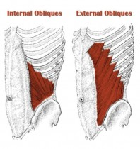
Lateral Abdominals (obliques)
Both perform trunk lateral flexion and rotation
External Oblique Muscles
Largest and most superficial of the abdominal muscles
Attaches to iliac crest, pubic crest, ribs and linea alba
Internal Oblique Muscles
Deep to the external oblique muscles.
Attaches to lower 3 ribs, pubic symphysis, linea alba

Slide 44
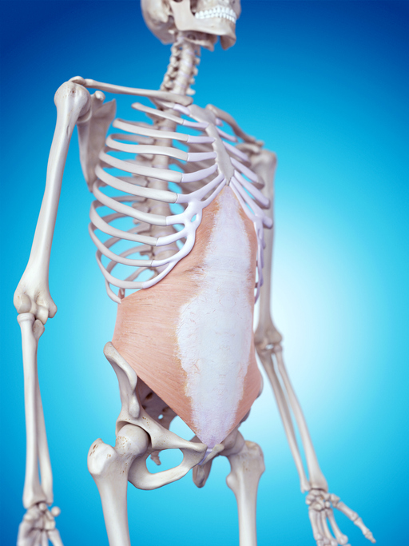
Transverse Abdominus
deepest of the abdominal muscles
stabilizes the trunk
Maintain internal abdominal pressure.
Attaches to:
Lumbar fascia, iliac crest, xyphoid process, linea alba and pubic symphysis

Slide 45
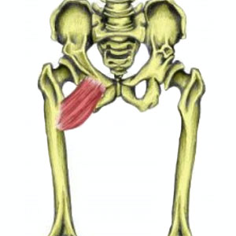
pectineus
Action: hip flexion, adduction and medial rotation
Attaches proximal below lesser trochanter of femur and superior pubic ramus
Major source of groin pain

Slide 46
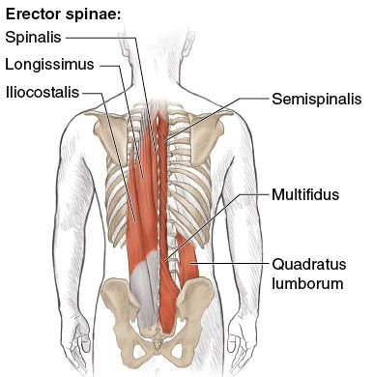
paraspinals
Various attachments to the spine and rib cage as well as the sacrum and the iliac crest
Pull sacral base superiorly and posteriorly (nutation)
Can help recruit and strengthen the lumbar multifidus muscles by tensing the pelvic floor muscles

Slide 47
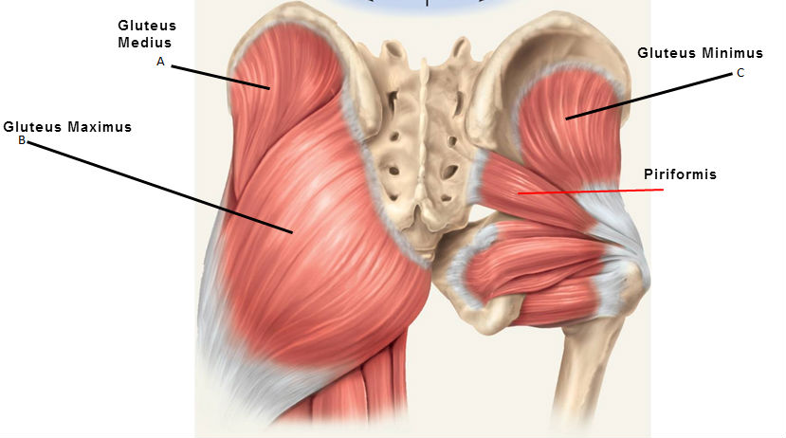
gluteus (minimus, medius, maximus)
Each attach on different areas of the ilium, the sacrum, the coccyx and the greater trochanter and IT band.
Actions: extend, abduct and rotate the hip
Essential for gait, proper pelvic alignment, propulsion during running, and single limb stance support

Slide 48
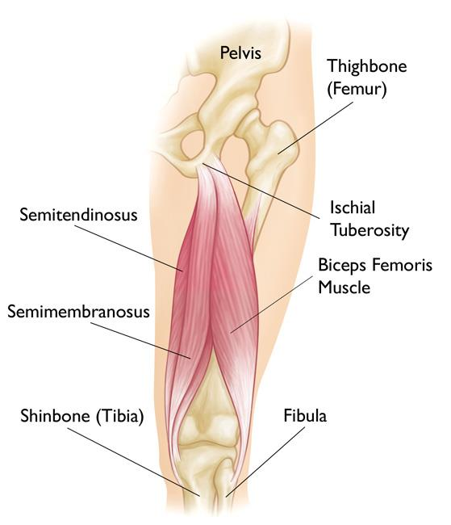
HAMSTRINGS
Attaches to the ischial tuberosity, fibular head, and posterior tibia.
Action: bend your knees and move your hips backwards
Essential for walking, running and jumping and they help you to achieve speed, power and agility

Slide 49
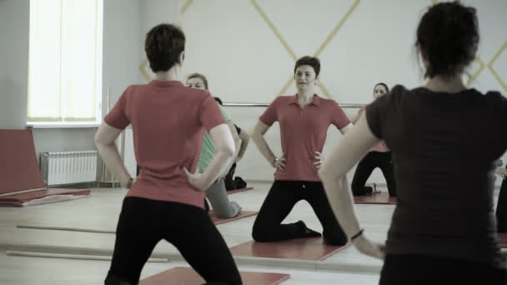
Practice
Sample Exercises
Examples of modification (s) for the pelvic floor
Notes:
9 m in per slide slides 49-66

Slide 50
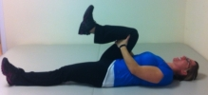
Stretching:
SKTC
Lay on your back. Bring one knee up to 90 degrees. Grab behind your knee and gently pull your knee to your chest.
single knee-to-chest to stretch your lower back, hamstrings and glutes

Slide 51
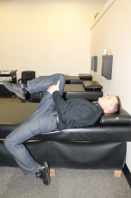
Hip Flexor / Thomas stretch
Lie back onto your back. You will likely feel a stretch in the front of the thigh and hip region in the leg hanging off the edge.
Bring the other leg up so you are pulling your knee towards your chest. You may feel a stretch in the buttock area or inner thigh region.
iliopsoas, quads, and opposite hams, gluts

Slide 52
Stretching
Child's Pose / Mid back stretch
Open the legs and bend forward.
Allow the pelvic floor to relax as you inhale deeply.
Lats, mid/low back, quads, gluts

Slide 53
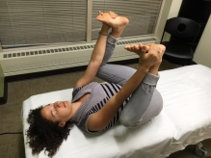
Stretching/Mobilization
Happy Baby / Modified DKTC
1. Position yourself as shown, grabbing onto the feet or behind the knees; you should feel a gentle stretch.
2. Breathe in and allow the pelvic floor muscles to relax.
3. Hold this position for 2-3 minutes.
Low back, gluts, quads, adductors, and hip rotators

Slide 54
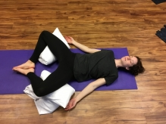
Stretching
Butterfly
Lay on back, bring feet together and knees out to the side. Place support under each knee at first then progress without support. Completely relax.
Hip adductors, iliacus, lower abdominals, quads

Slide 55
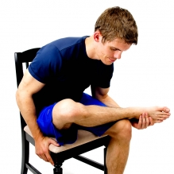
HIP STRETCH – SEATED
While sitting in a chair, cross your affected leg on top of the other as shown.
Sit up straight (anterior tilting pelvis)
Gently lean forward until a stretch is felt in the hip/buttock along the crossed leg.
Low back, quads, gluts, hip rotators
Notes:
Pudendal Neuralgia!

Slide 56
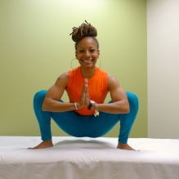
Stretching
Deep Squat
1. Assume a deep squat position, with elbows between the knees and heels firmly planted on the ground (you may prop up against a wall or use a yoga block under the buttock).
2. Relax your pelvic floor and try to deepen into the stretch.
3. Hold this position for 2-3 minutes, breathing deeply.
ankles, quads, adductors, gluts, pelvic floor

Slide 57
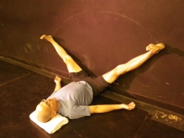
Wall Stretch “V”
Slide feet up the wall, keeping the hips as close to the bottom of the wall as possible.
Keep your coccyx (tailbone) down into the floor as much as possible (don’t arch the back)
Separate legs until a stretch is felt in the inner thighs.
Use your hands (or a strap) to assist the legs back up to the starting position at the conclusion of the stretch.
hamstrings, adductors, pelvic floor

Slide 58
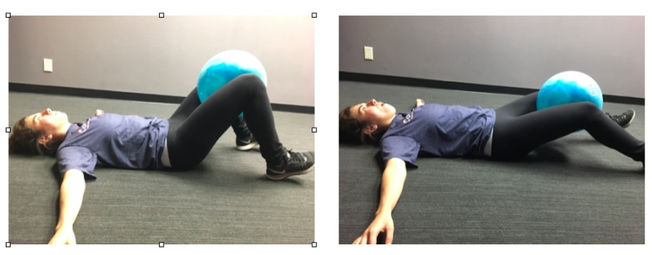
Strengthening
Ball Squeeze Series
Begin with feet on the floor, knees bent to 90 degrees and ball between inner thighs.
Perform a flattening the back by placing a towel under the sacrum
Squeeze ball between thighs.
Repeat exercise with knees extended 45 degrees and near fully extended.
Notes:
Activate anterior pelvic floor

Slide 59
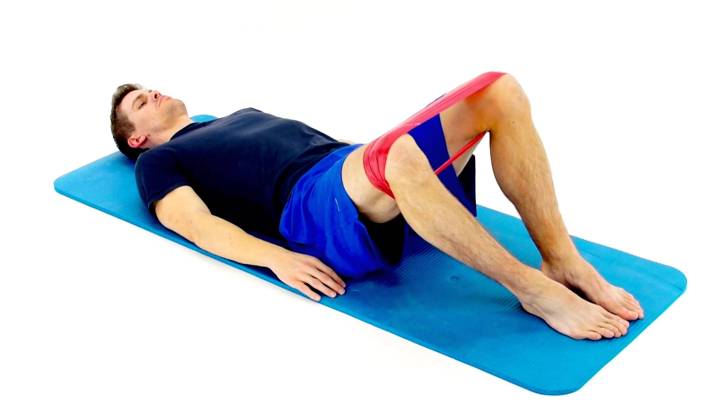
Strengthening
SUPINE HIP ABDUCTION
Isometric
Position is most important!
Knees fully bent. Towel under the sacrum.
Wrap a belt or tie a sheet around your thighs.
Use a towel roll under the foot to increases DF
While lying on your back attempt to pull apart your legs and hold.
Isokinetic Resisted –
Lie down on your back with your knees bent. Place an elastic band around your thighs and then press your legs apart. Control the eccentric motion.
Gluts (med/min), tensor fascia latae (TFL), obturator internus, the levator ani / coccygeus
Notes:
Activate posterior pelvic floor

Slide 60
Strengthening
SIDELYING CLAM SHELL
While lying on your side with your knees bent, press down with your hand and raise up the top leg about 6 inches while keeping contact of your feet together as shown.
Position is most important!!
Line up the heels with the sacrum and “lock out” the upper back.
Do not let your pelvis roll back during the lifting movement.
Use towel rol under the ankle t help with this.
Add resistance with band
gluteus medius, gluteus maximus, TFL, piriformis
Notes:
Piriformis, posterior pelvic floor

Slide 61
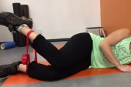
Strengthening
Reverse Clam Shells
Lie on side as you did with forward clam shells
Add resistance with band around ankles.
Keep hips rolled forward and knees together
Pull the ankles apart while squeezing glutes.
Control the eccentric lowering back down.
glut med/min, TFL, adductors (brevis, longus and magnus and some QL
Notes:
Obturator Internus

Slide 62
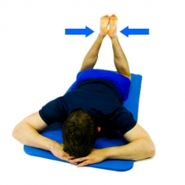
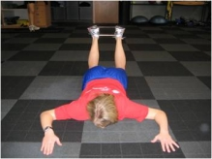
Strengthening
Isometric - IR
While lying face down, knees apart and press your heels together.
Use towel roll under bilat. ASIS to stabilize pelvis
ER Resisted – with band
Lying prone on the floor, keep the abdominals tight to avoid movement of the low back (can pillow under abdomen for support) Move the heels apart stretching the band, keep knees hip width apart.
gluts, TFL, adductors, piriformis, obturator internus
Notes:
Obturator Internus

Slide 63
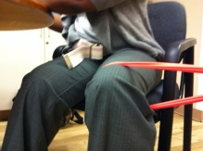
Strengthening
Hip IR/ADD – modified to seated
Sit with bent knee. Place band around one leg just above the knee.
Move leg in against the band resistance.
Exercise can be done keeping the foot in place on the ground or moving foot with knee.
Put the band the opposite way for ER/ABD

Slide 64
Strengthening
Abdominal series - advanced
Lay on your back with your arms and legs at 90 degrees with exercise ball between the calves.
Lift up to take the ball from the leg. Lay back slowly lowering the ball backwards over the head.
Lift back up and return the ball to the starting position.
To begin with a lower level
Place ball between the knees, then between the ankles, then using just the arms and progress to arms and legs from the knees, the ankles and then to straightening the legs as shown.

Slide 65
Retraining / Relaxation
Lying on you back with your feet on the wall, knees bent to 90 degrees, hips flexed to 90 degrees, place a ball/pillow/towel roll between your knees. Start with right arm overhead, left arm using balloon. Push your left heel into the wall and squeeze the ball between your knees. Inhale a deep breath and exhale completely to blow up the balloon. Relax. Repeat 2 – 5 times.
Repeat with the other side.
This is for relaxation of the pelvic floor to assist with evacuation of the bowel and/or bladder
Notes:
Relax the pelvic floor

Slide 66
Thank You for Attending
Be sure to sign-out before leaving the session. Credit will NOT be issued after conference if requested via phone or email for attendees who did not sign-in AND out. Credits from conference can be accessed in your TPTA Profile at www.tpta.org. Login to the same profile used when registering for conference to access credits November 15, 2019.
Course Evaluations are available at every session and may be returned to the Course Proctor or TPTA Registration Desk.
See you next year for Annual Conference 2020! The Westin Irving Convention Center Hotel at Las Colinas October 30th -31st, 2020

